Slide 1
WORLD POPULATION ANALYSIS
GALLA GIRIDHAR
2320727

Slide 2
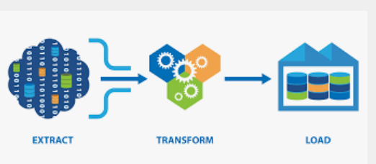
ETL
EXTRACT:Extracting data from source.
TRANSFORM : Cleanse the data to improve data quality and establish consistency
LOAD: Load data into a target database

Slide 3
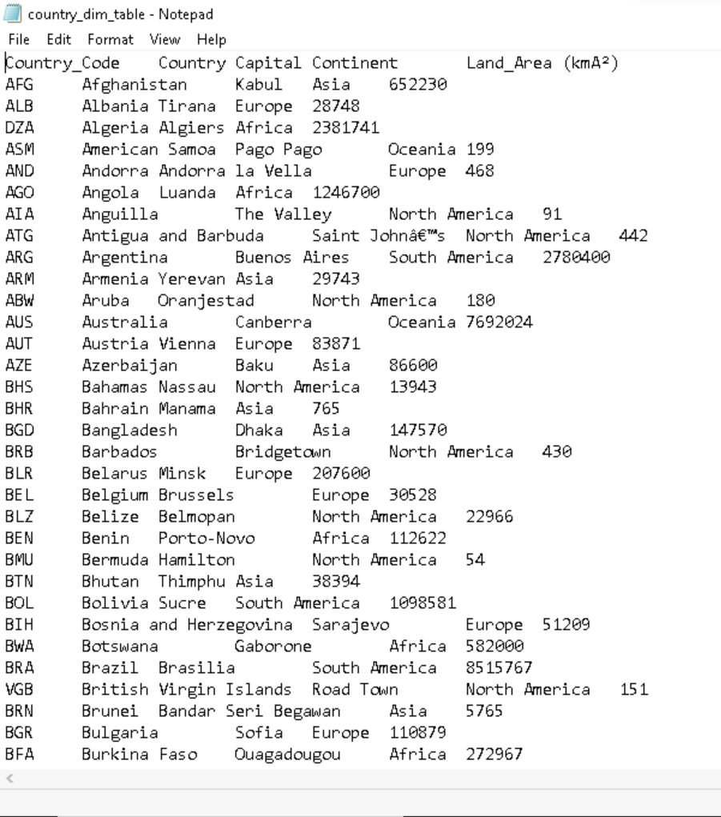
Source
Country Dim
The source is a Flat File.

Slide 4
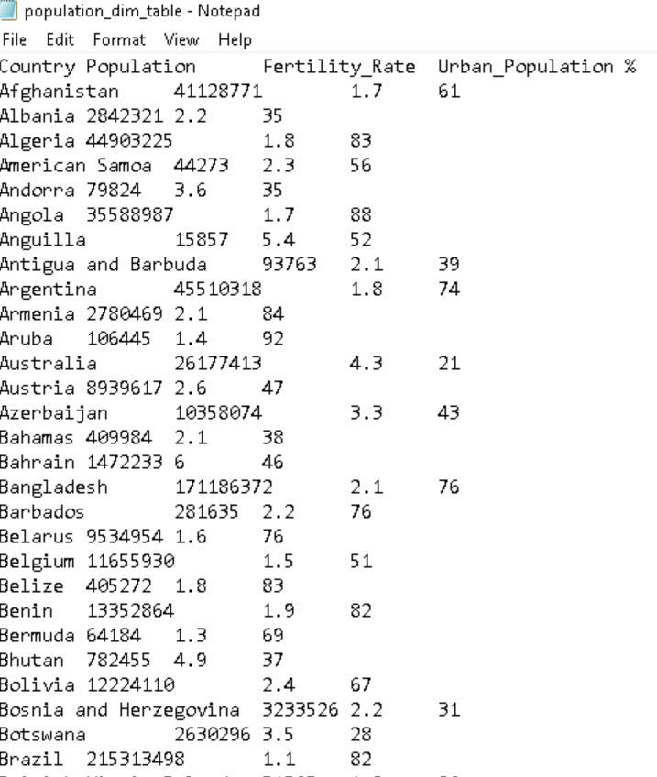
Source
Population Dim

Slide 5
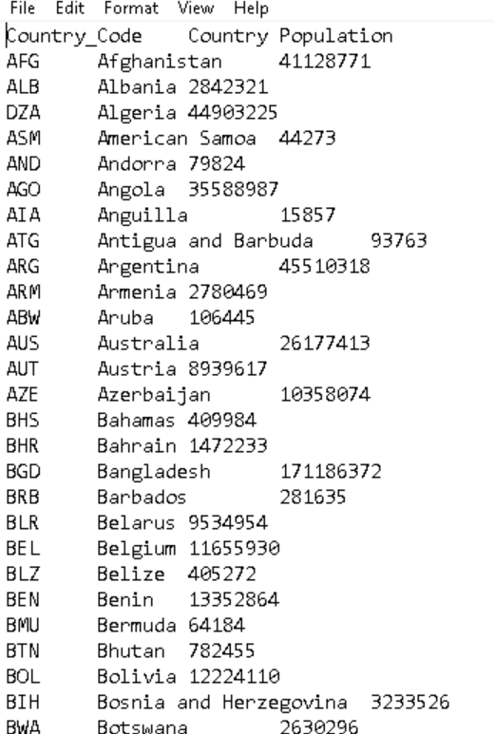
Source
Fact Table

Slide 6
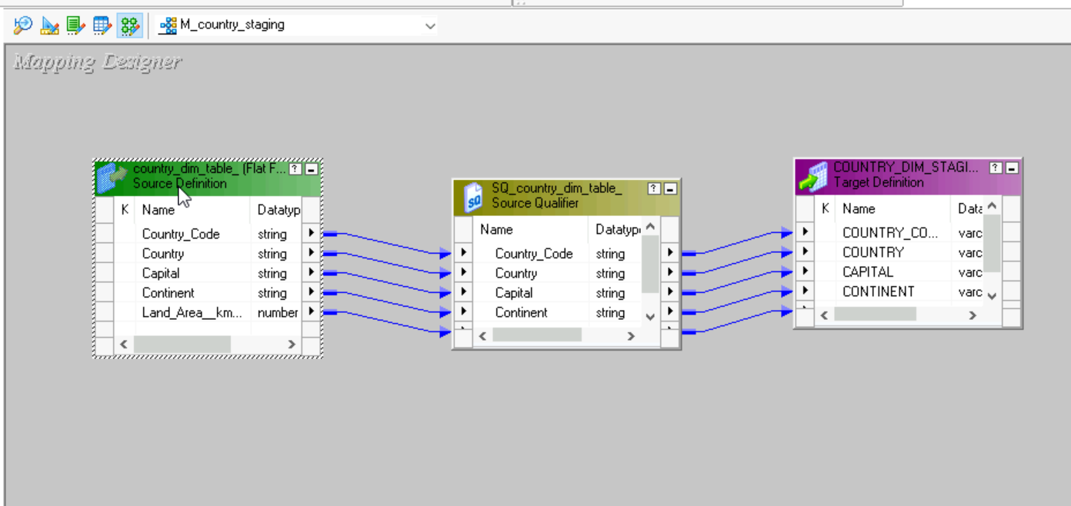
Staging Area
Country Staging
Converting my flat file source into a relational table using the below mapping.

Slide 7
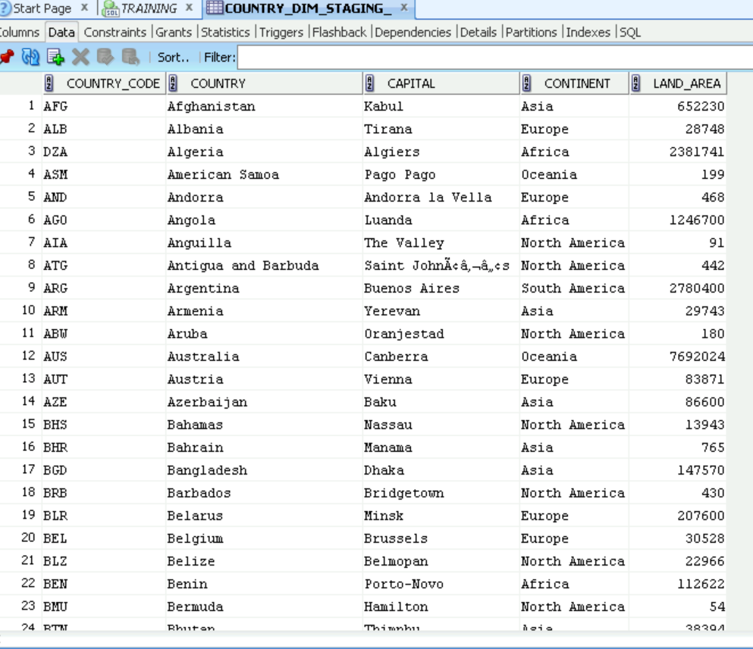
Staging Output (Country Dim)

Slide 8
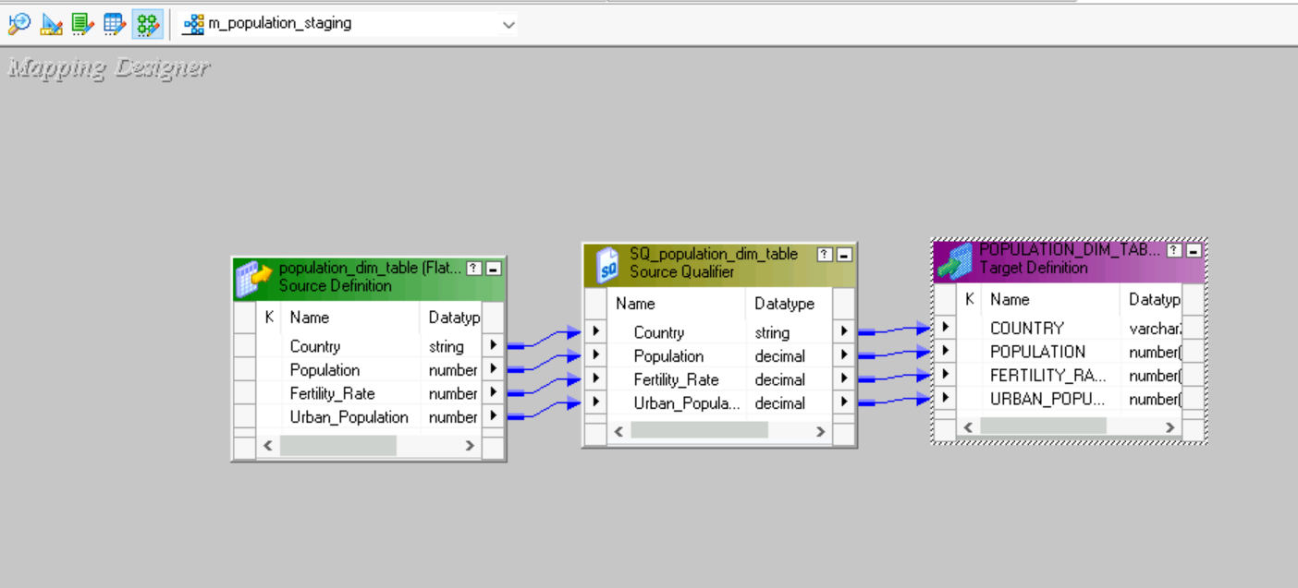
Staging Area
population Staging
Converting my flat file source into a relational table using the below mapping.

Slide 9
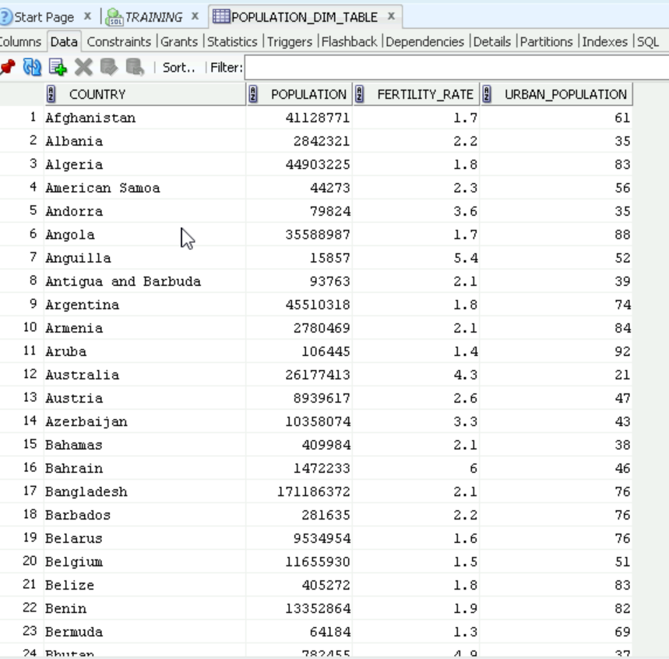
Staging Output (Population Dim)

Slide 10
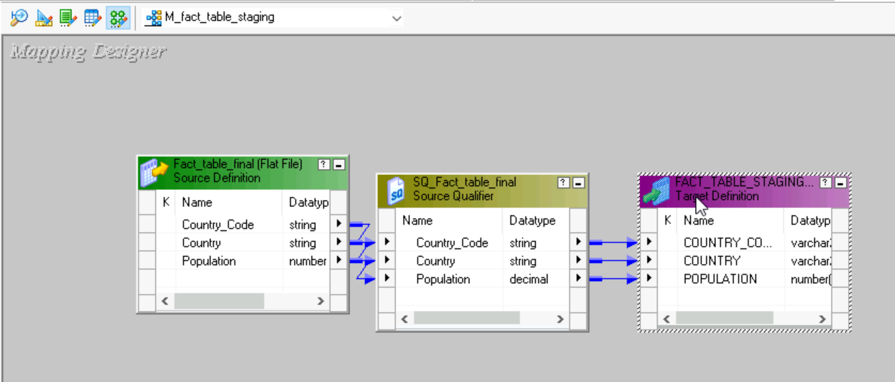
Staging Area
Fact Table Staging
Converting my flat file source into a relational table using the below mapping.

Slide 11
Staging Output (Country Dim)

Slide 12
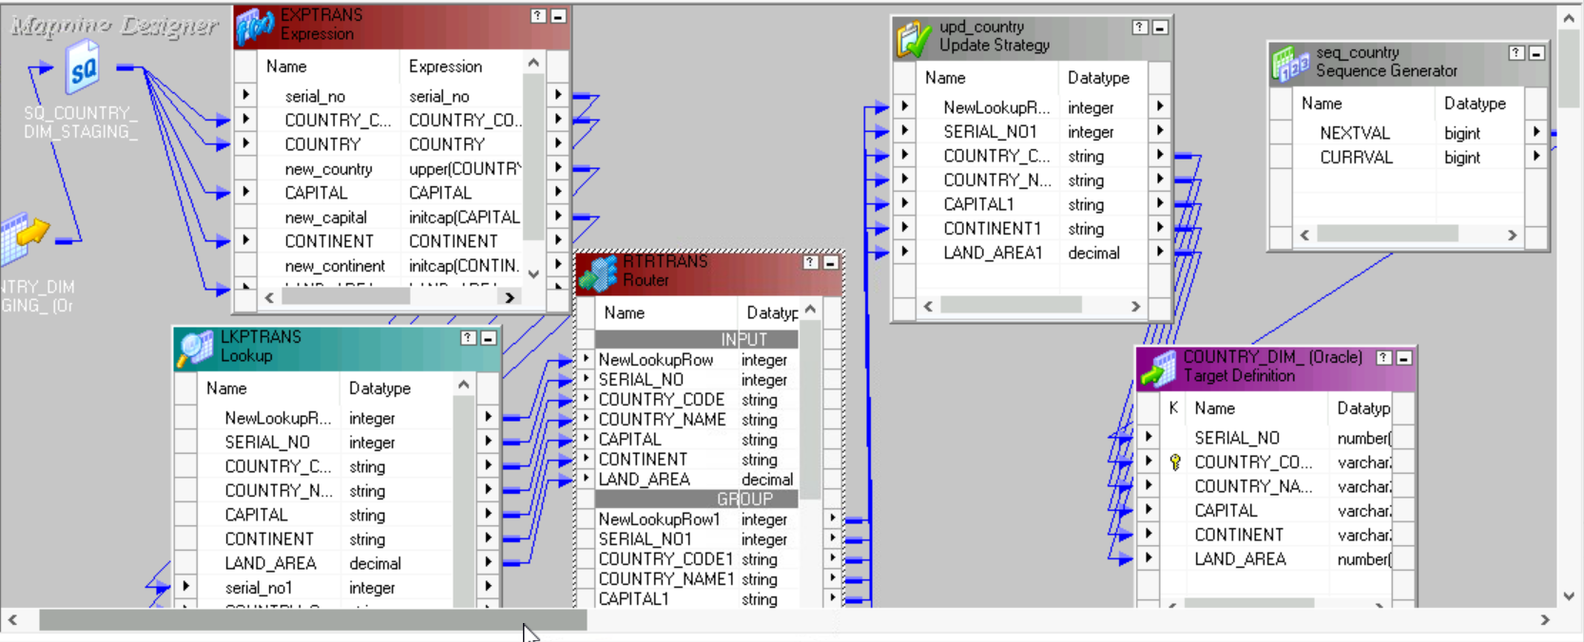
Country Mapping

Slide 13
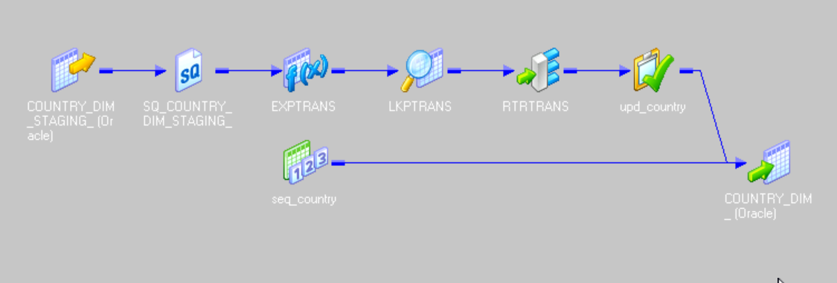
Country Mapping (iconic)

Slide 14
Transformations Used
Expression:
Upper(Country)
Initcap(Capital)
Initcap(Continent)
Router:
NewLookupRow=1 OR NewLookupRow=2
Update Strategy:
iff(NewLookupRow1=1,DD_INSERT,DD_UPDATE)
Expression
Lookup
Router
Update strategy
Sequence Generator

Slide 15
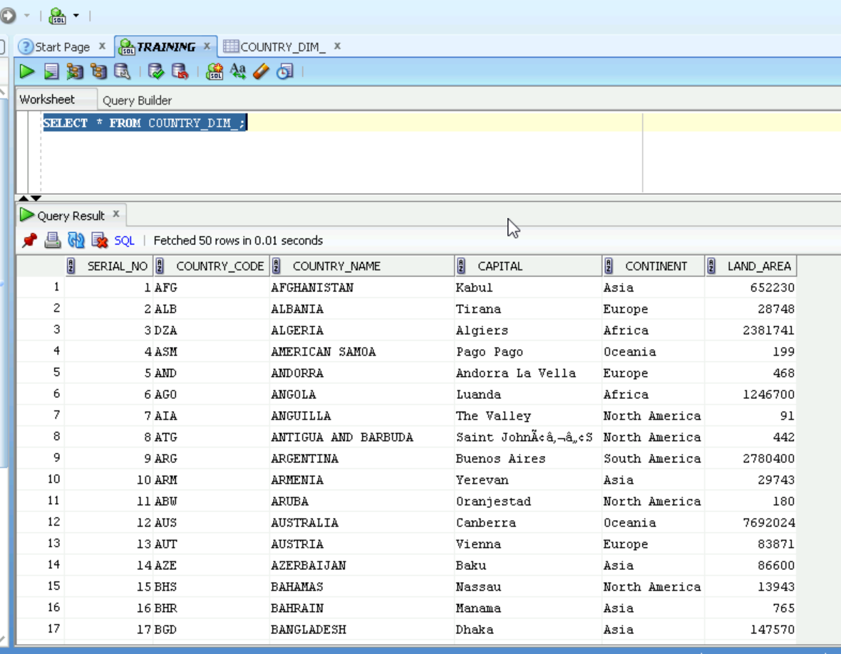
Country Output

Slide 16
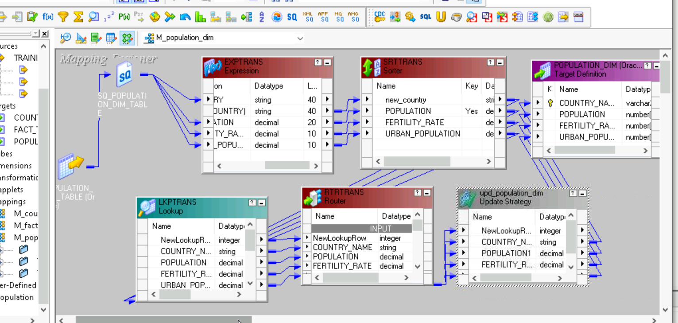
Population Mapping

Slide 17
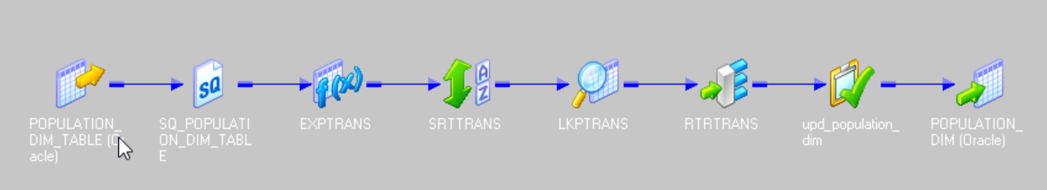
Population Mapping (iconic)

Slide 18
Transformations Used
Expression:
upper(Country)
Router:
NewLookupRow=1 OR NewLookupRow=2
Update Strategy:
iff(NewLookupRow1=1,DD_INSERT,DD_UPDATE)
Expression
Lookup
Router
Update strategy
Sorter

Slide 19
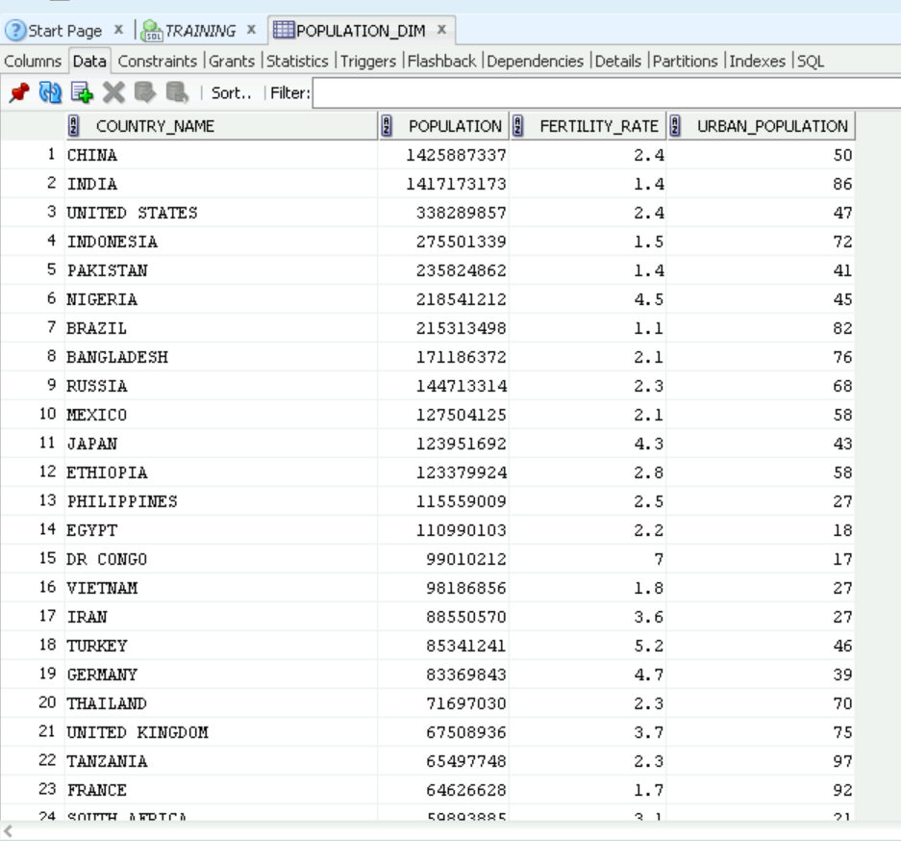
Population Output

Slide 20
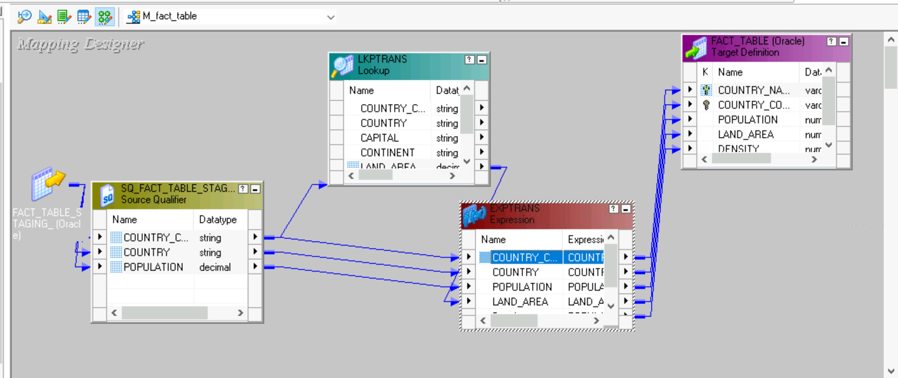
Fact Table Mapping

Slide 21
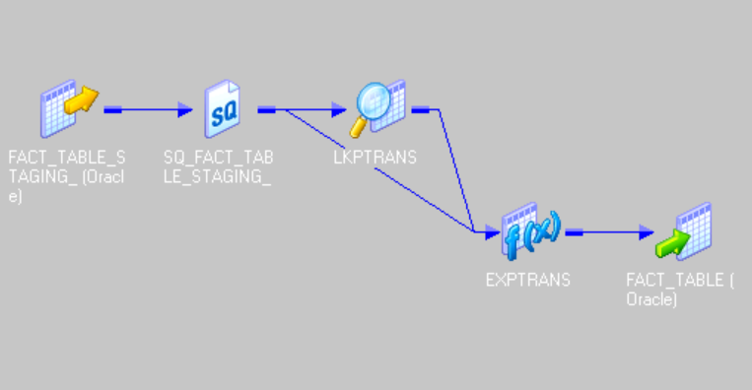
Fact Table Mapping (iconic)

Slide 22
Transformations Used
Expression:
density= Population/land area
LookUp: source base Lookup.
Expression
LookUp

Slide 23
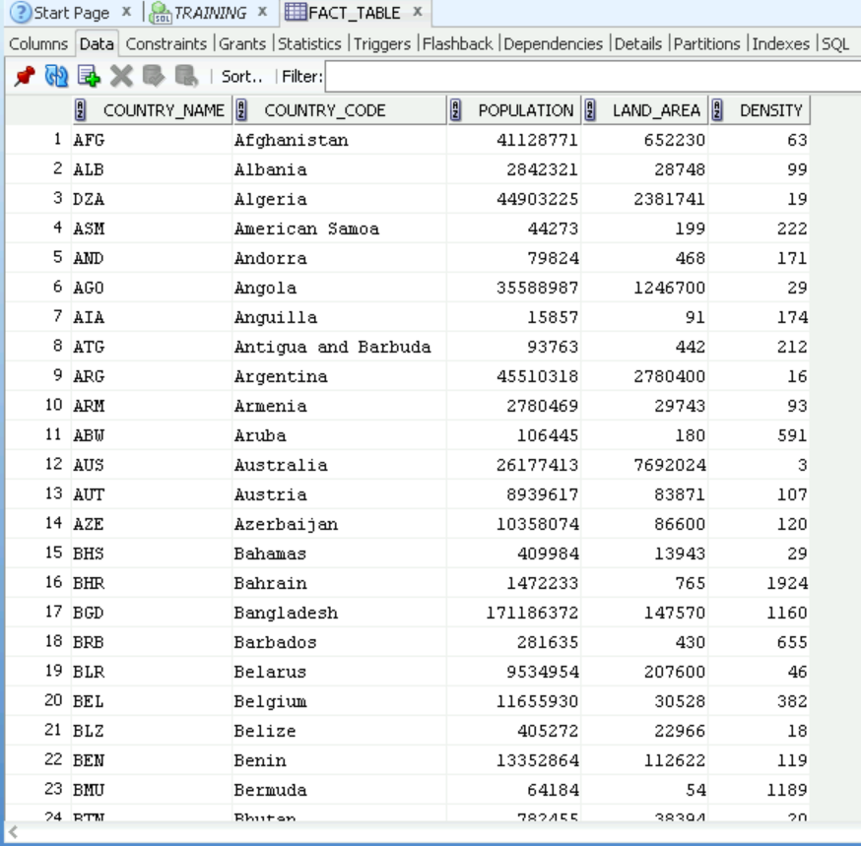
Fact Table Output

Slide 24
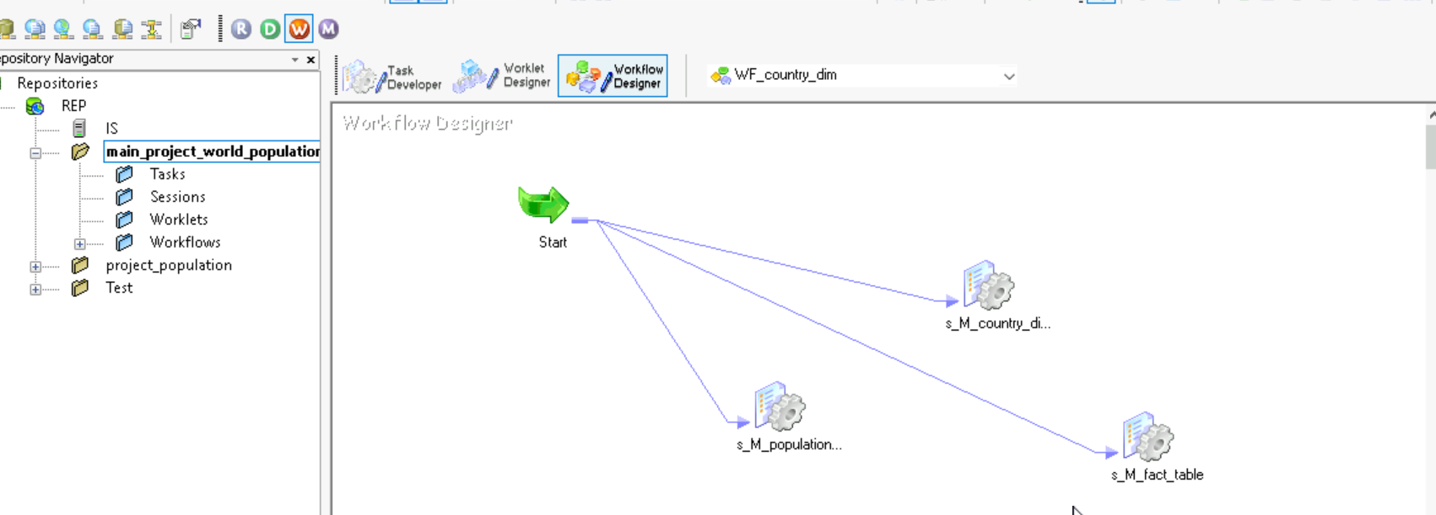
Work Flow

Slide 25
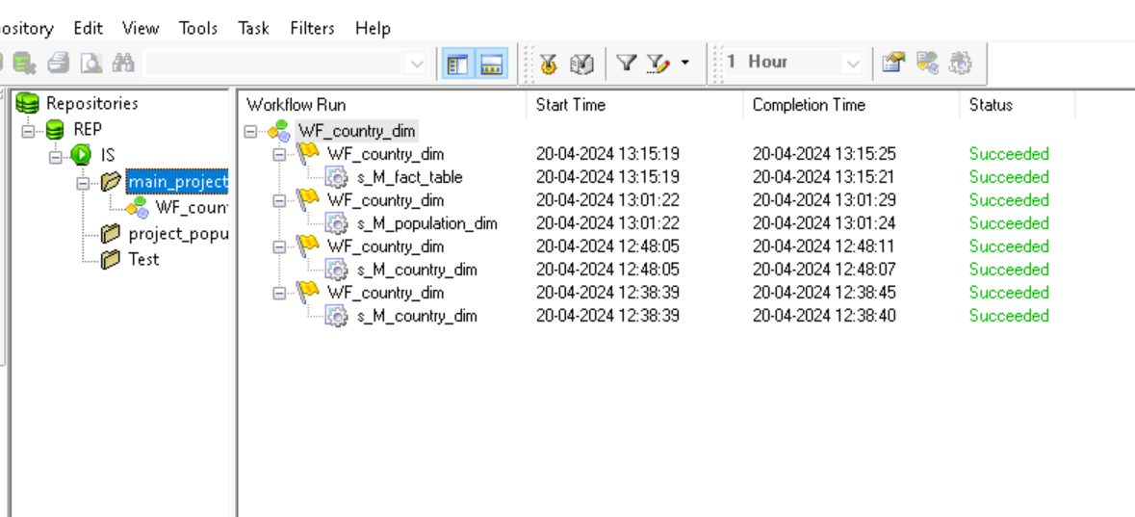
Work Flow Monitor Result:

Slide 26
ETL Validations
Validations:
1)Count Validation
2) Data Validation
3) Null Character Validation
4) Duplicate Validation

Slide 27
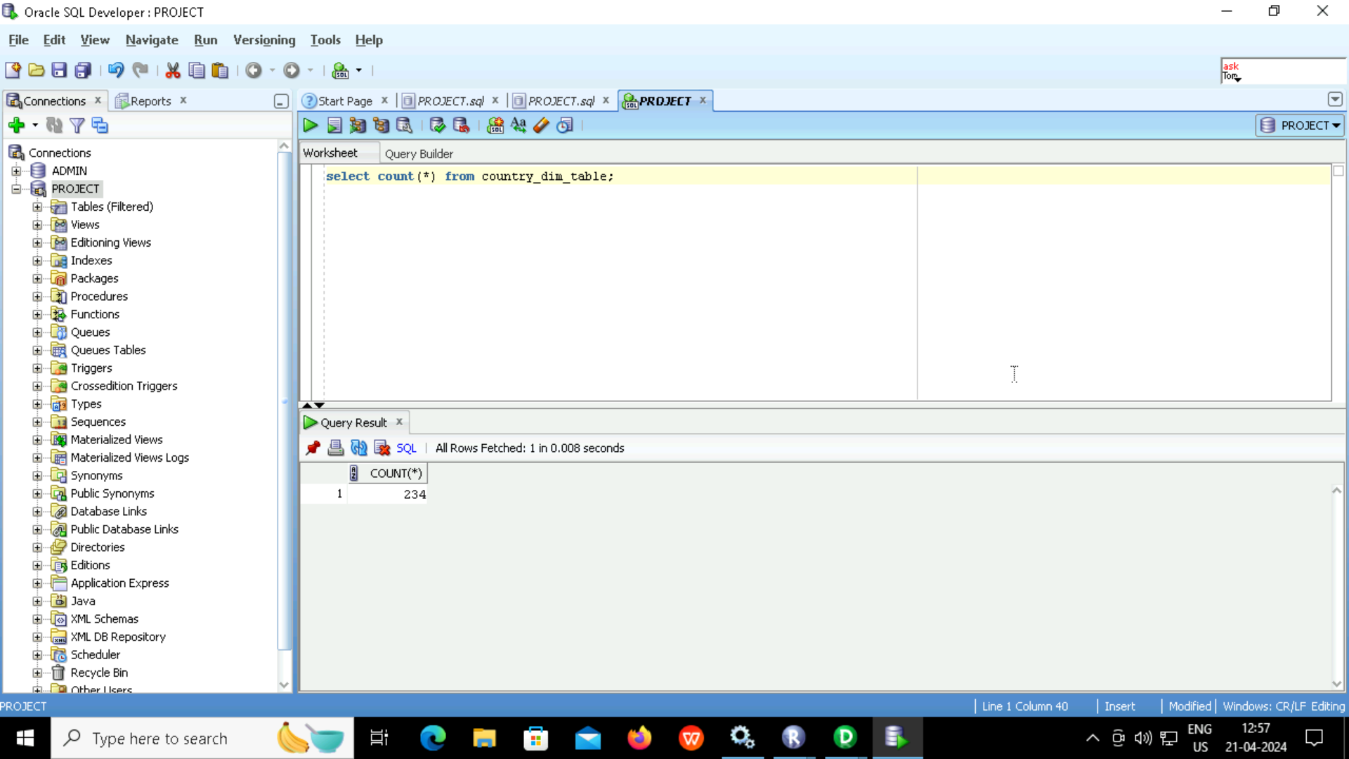

Count validation (Country)
Source
Target

Slide 28


Count validation (Population)
Source
Target

Slide 29
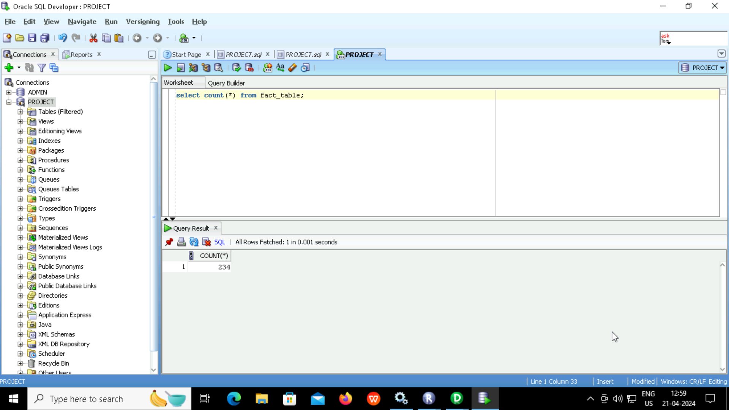

Count validation (Fact Table)
Source
Target

Slide 30
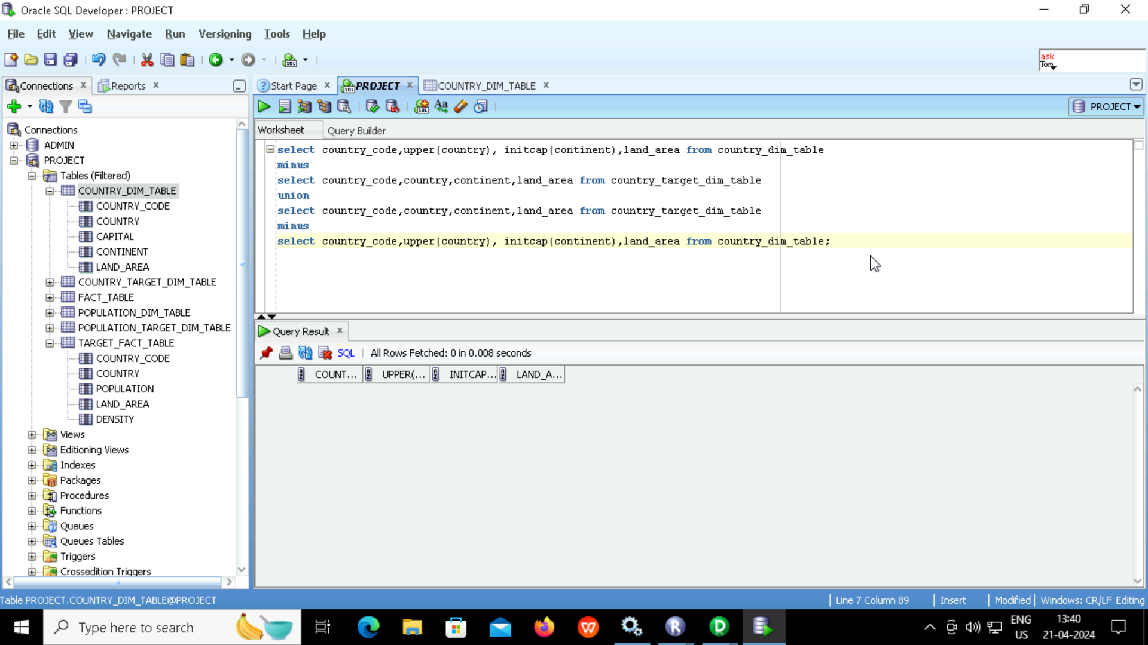
Data validation (Country)

Slide 31
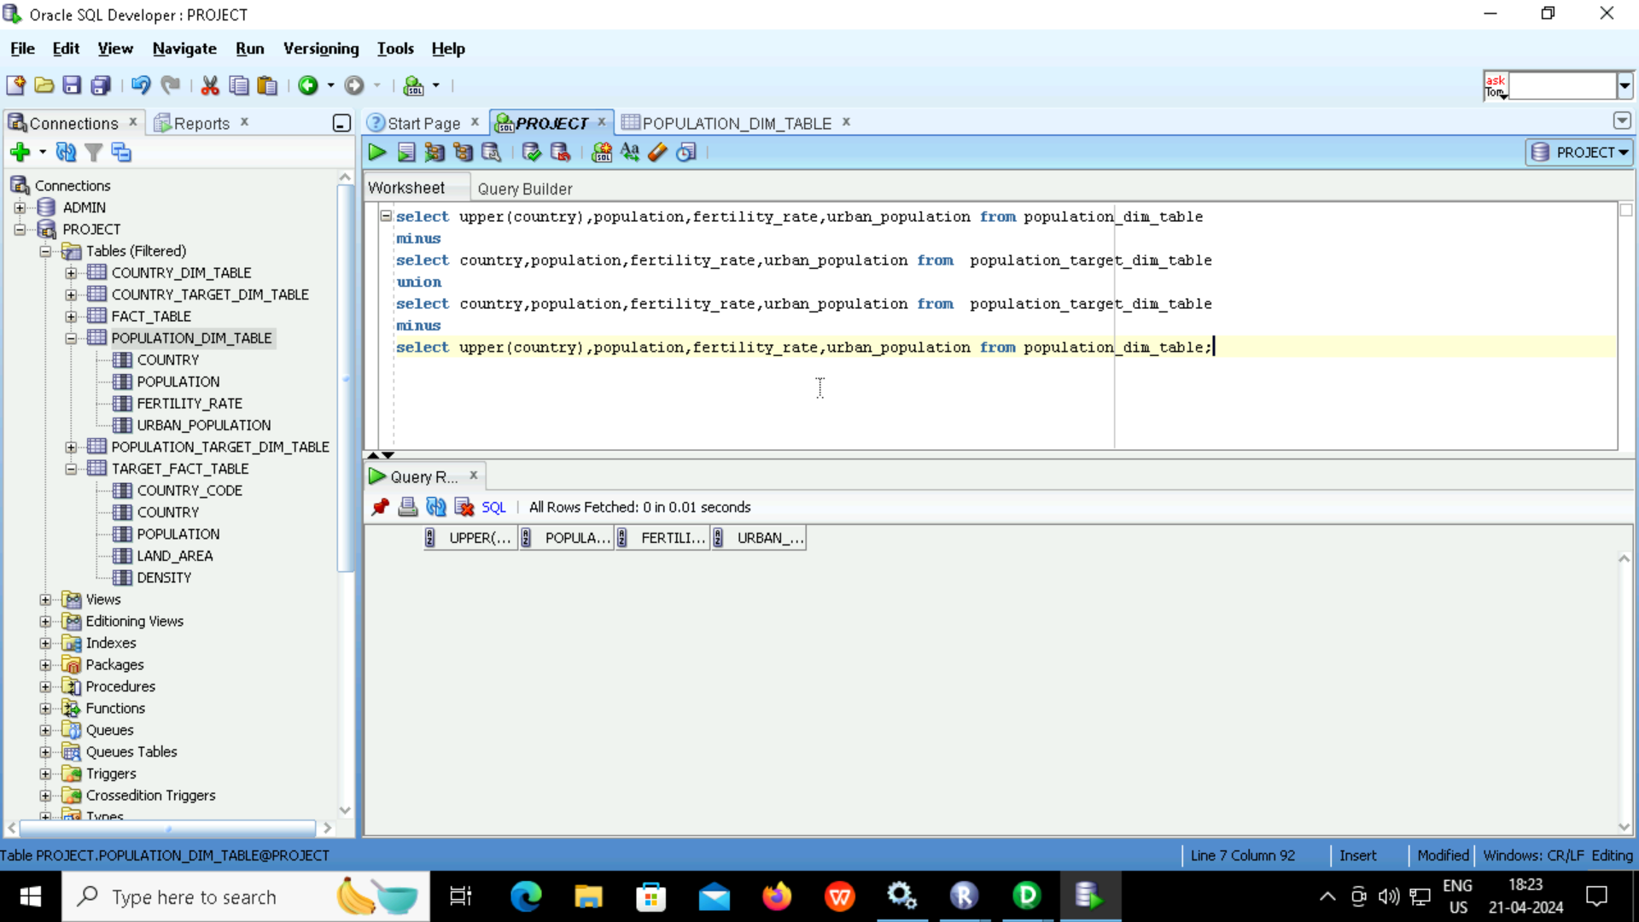
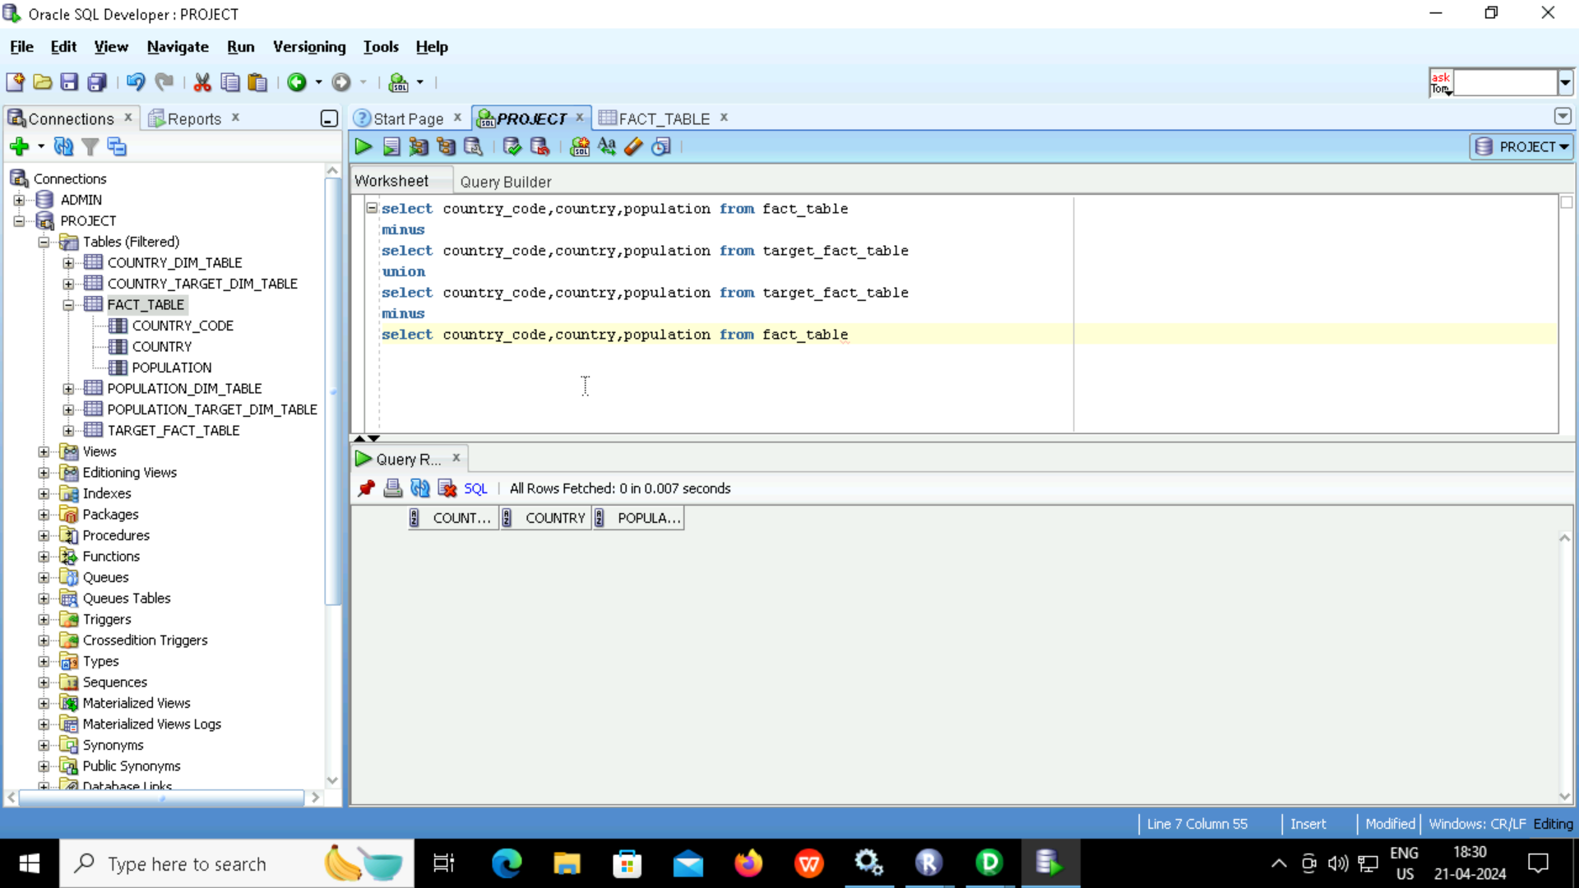
Data validation (Population ,Fact Table)

Slide 32
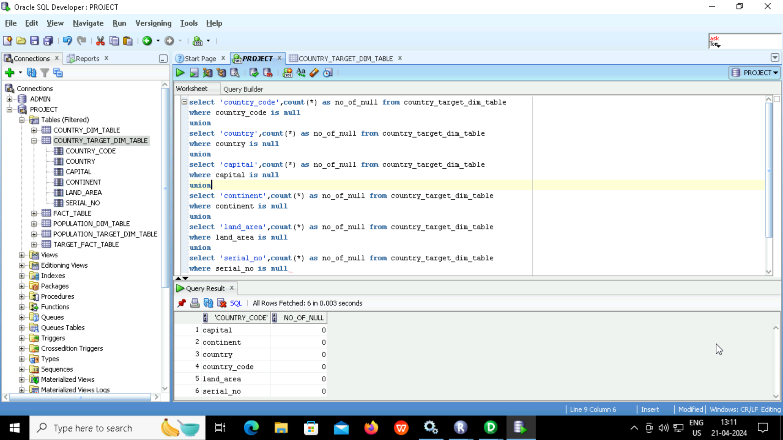
Null Character Validation (Country)

Slide 33
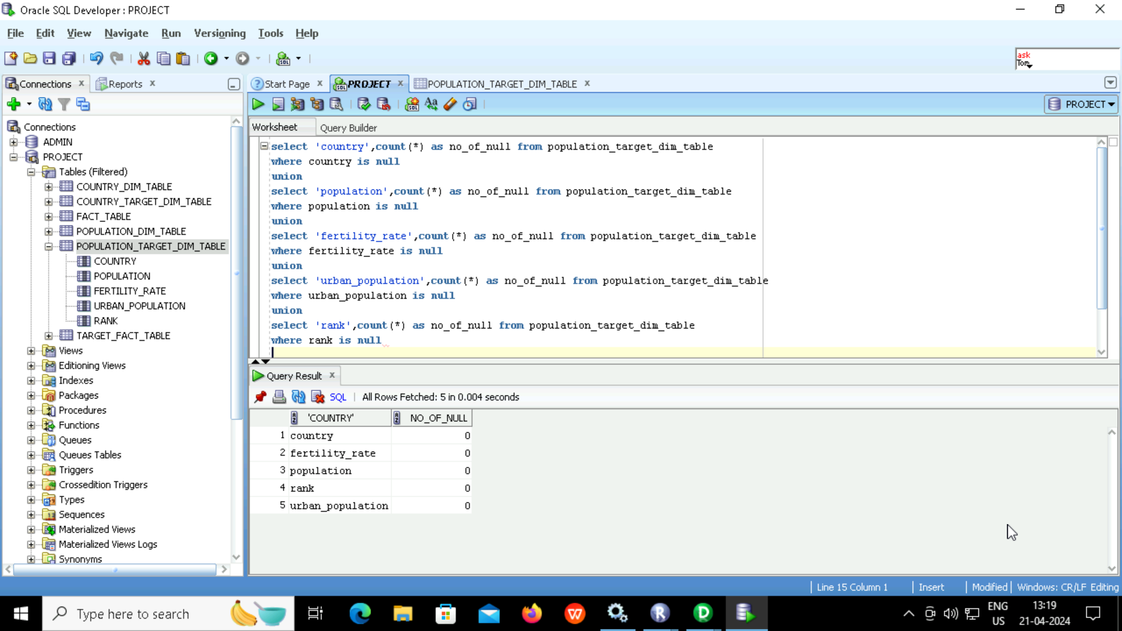
Null Character Validation (Population)

Slide 34
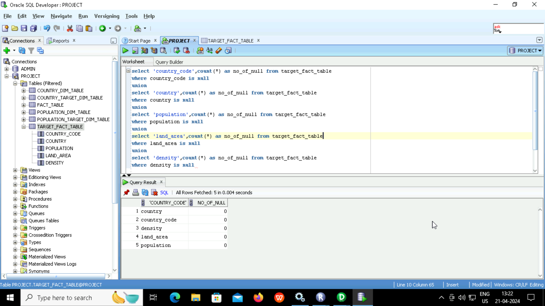
Null Character Validation (Fact Table)

Slide 35
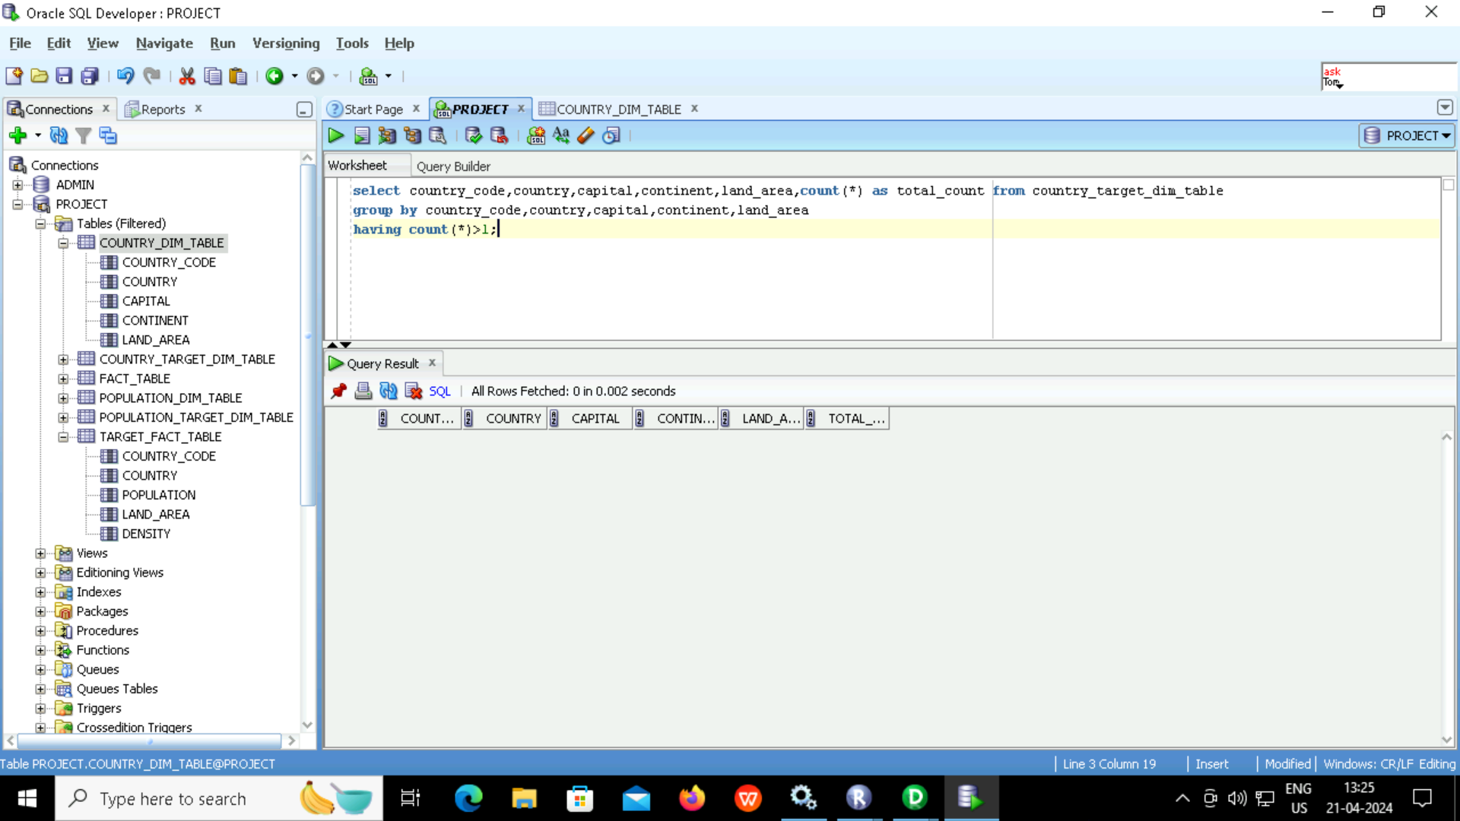
Duplicate Validation (Country)

Slide 36
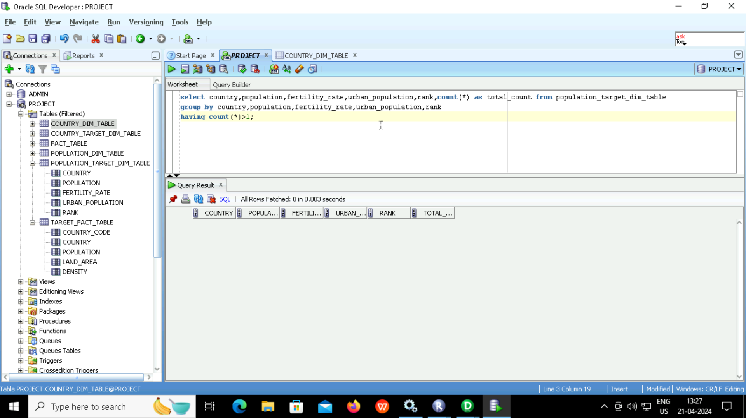
Duplicate Validation (Population)

Slide 37

Duplicate Validation (Fact Table)

Slide 38
Conclusion
There are 2 dimension and one fact table
Country and Population tables are the dimension tables and world population table is the fact table
I have calculated the density of all 234 countries by dividing the population with land area using the required transformations.

Slide 39
Thank You

